Slide 1
Personality
DR J BALAMURUGAN

Slide 2
Meaning of Personality
The word personality derived from the Latin word persona, which means mask.
Personality refers to individual differences in characteristic patterns of thinking, feeling and behaving.
Personality is what makes a person as a unique person.

Slide 3
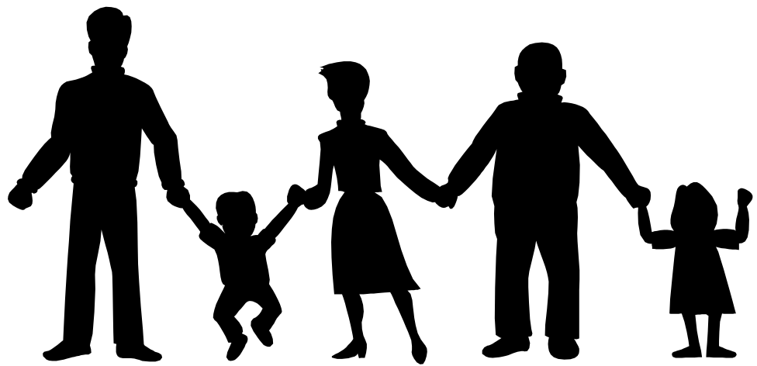
Introduction of Personality
“Characteristic patterns of behaviour and modes of thinking that determine a person’s unique way of interacting with the environment”
The unique ways of interaction of the person (behaviour and modes) is called as personality.

Slide 4
Conti..
Individual differs widely from each other in feelings, emotions, cognitions and ways of responding to the various aspects.
Such differences are also found in their effectiveness to respond to the situations.
Everyone’s social effectiveness is unique and leaves unique impressions of him on others.
This uniqueness refers to one’s PERSONALITY which marks his identity distinct from others.

Slide 5
Definition of Personality
According to Funder, “Personality refers to individuals' characteristic patterns of thought, emotion, and behavior, together with the psychological mechanisms.
According to Gordon Allport “personality is the dynamic organisation within the individual of those psychophysical systems that determine his unique adjustments to his environment.”

Slide 6
3 Facts to Consider When Defining Personality
Individuals are unique
Individuals behave differently in different situations
Although individuals are unique and behave inconsistently across situations, there is considerable commonality in human behavior

Slide 7
Factors Determining Personality
Socio-demographic Factors
Heredity
Environment
Physiological Differences
Shared Vs Solitary Experience

Slide 8
Components of Personality
Consistency - There is generally a recognizable order and regularity to behaviors. Essentially, people act in the same ways or similar ways in a variety of situations.
Psychological and physiological - Personality is a psychological construct, but research suggests that it is also influenced by biological processes and needs.
It impacts behaviors and actions - Personality does not just influence how we move and respond in our environment; it also causes to act in certain ways.
Multiple expressions - Personality is displayed in more than just behavior. It can also be seen in our thoughts, feelings, close relationships and other social interactions.

Slide 9
Types of Personality
A lot of personality – refers to the attractiveness of the person in reference
A poor personality – refers to such attributes which are usually discarded
No personality – refers to the person does not posses any qualities
Aggressive personality and Shy personality
Extrovert personality and Introvert personality

Slide 10
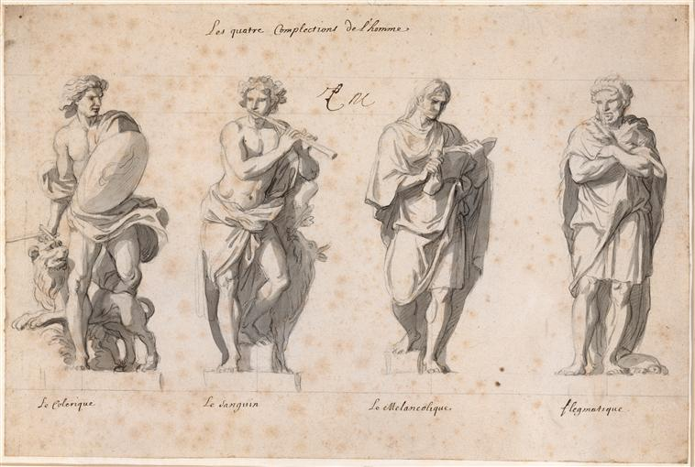
Types of Personality
Sanguine (Air) (pleasure-seeking and sociable)-people-oriented extroverts
Choleric (Fire) (ambitious and leader-like) -task-oriented extroverts
Melancholic (Water) (analytical and literal)-task-oriented introverts
Phlegmatic (Earth) (relaxed and thoughtful)-people-oriented introverts

Slide 11
Theories of Personality
Different schools of thought in psychology influence many of theories….
Trait theories
Type theories
Psychodynamic theories
Behavioral theories
Humanist theories

Slide 12
Trait theory of personality
Trait theory - “An individual’s personality, is his unique pattern of traits.”
A trait can be thought of as a relatively stable characteristic that causes individuals to behave in certain ways and differs from others.
Eg: Outgoing, kind, smart,

Slide 13
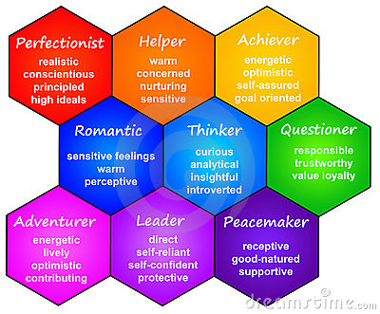

Slide 14
Trait theory - Gordon Allport
The cardinal traits are those that dominate personality to the point that people are famous for them.
The central traits are the major characteristics you might use to describe another person. Terms such as intelligent, honest, shy and anxious are considered central traits.
The secondary traits are the traits that are sometimes related to attitudes or preferences and often appear only in certain situations or under specific circumstances.
Eg would be getting anxious when speaking to a group or impatient while waiting in line.

Slide 15
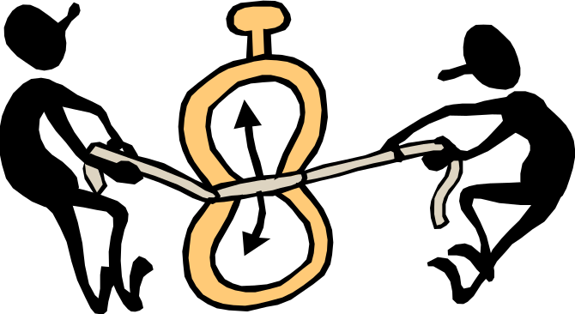
Type theory of personality
Type A Personality is...
Always in a hurry
Uneasy when waiting
Eats, walks fast
Sets own deadlines; self motivated
Goal-oriented
Hard-driving
Must finish tasks
Never late for appointments
Highly Competitive
Tends to interrupt others

Slide 16
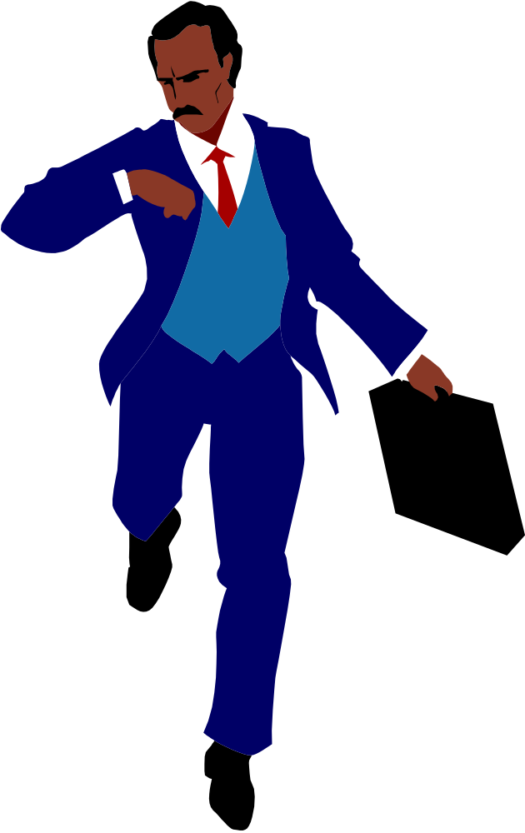
Characteristics of Type A Personality
Insecurity of Status
Hyperaggressiveness
Sense of Time Urgency
The Drive to Self-Destruction
Free-Floating Hostility

Slide 17
Adverse Effects of Type A Personality:
Hypertension
Heart Disease
Job Stress
Social Isolation

Slide 18

Type B Personality is...
Easy-going
Can leave tasks
Late for appointments
Cooperative
Listens well
Not hurried
Content to wait
Does things slowly
Tends to not set deadlines
Methodical

Slide 19
Type A versus Type B Personality
Type A individuals have an intense desire to achieve, are extremely competitive, have a sense of urgency, are impatient, and can be hostile
Type B individuals are more relaxed and easy going
Notes:
Students may think that the Type A personality individual will be the more desirable employee. However, Type As can create conflict and be difficult to work with. Type As also tend to overestimate what can be done in a period of time. Consequently, deadlines may not be met.

Slide 20
Measures of Personality
Interviews
  Unstructured: “Tell me about yourself…”
  Structured: Set list of questions
Observation
Objective tests
Projective tests

Slide 21
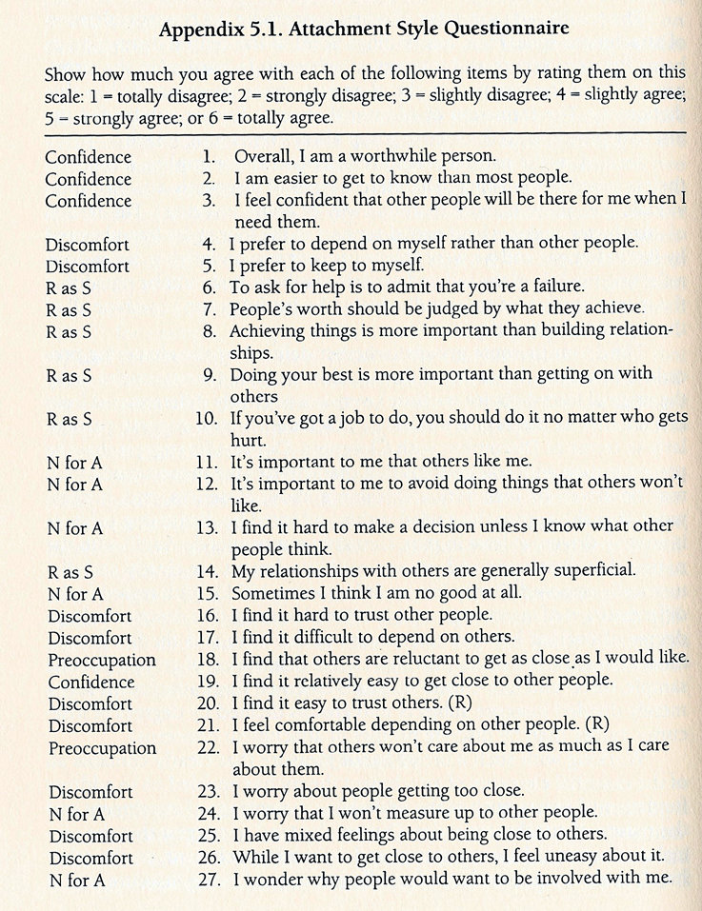
Sample Questionnaire – objective test

Slide 22
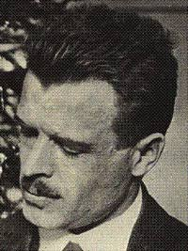
Assessing the Unconscious -- Rorschach
RORSCHACH Inkblot Test
  the most widely used projective test
  a set of 10 inkblots designed by Hermann Rorschach
  used to identify people’s inner feelings by analyzing their interpretations of the blots
Rorschach

Slide 23

Assessing the Unconscious—Rorschach Test (RT)

Slide 24
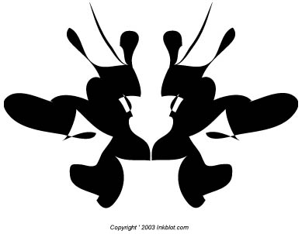


Slide 25
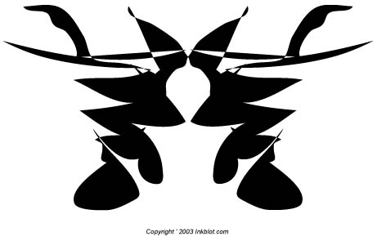


Slide 26
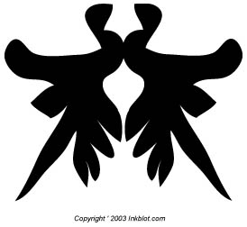


Slide 27
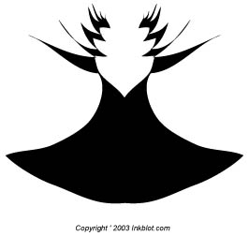
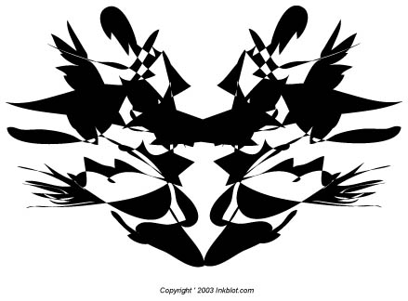

Slide 28
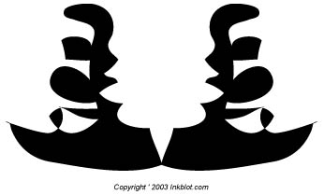


Slide 29
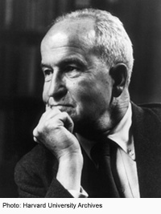
Assessing the Unconscious--TAT
MURRRAY devised a projective test of personality which is known as TAT.
Thematic Apperception Test (TAT)
People express their inner motives through the stories they make up about ambiguous scenes

Slide 30
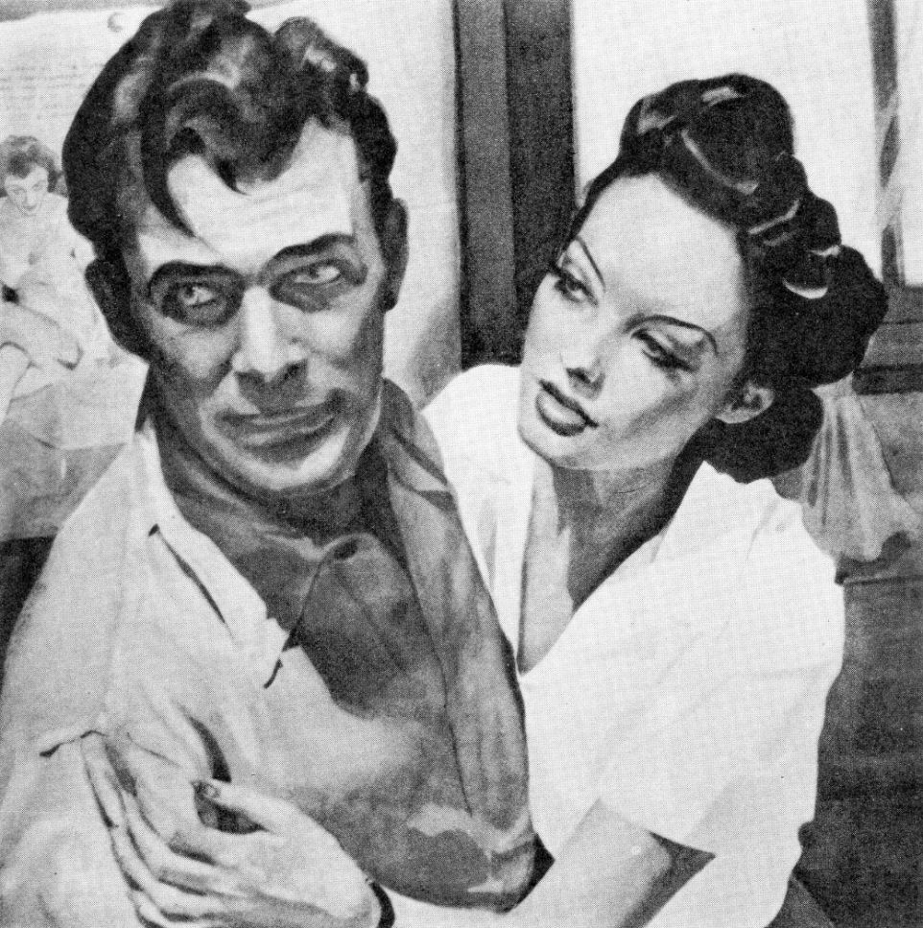
Picture card represent different situation

Slide 31
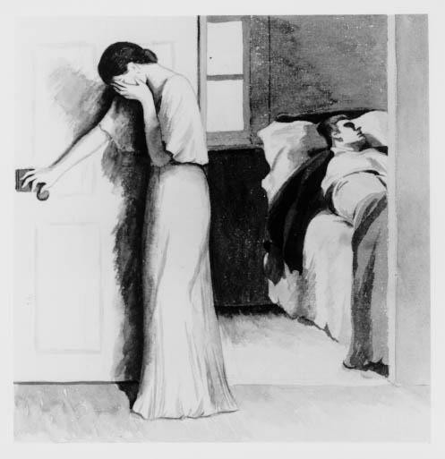

Slide 32
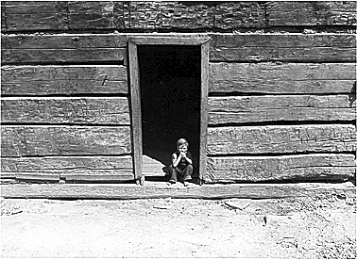
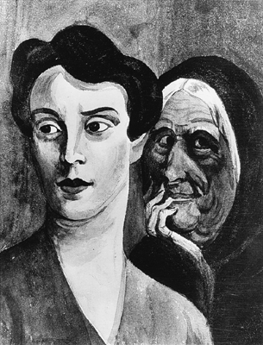

Slide 33
FUN
Personality Tests

Slide 34
Personality Test I)
1- Think on the first three animals which you like most. Write them all (Do not think too long. Just write down which comes 1st to your mind as your favorite animal).
  The first one should be the one which you like most. The 2nd one your 2nd favorite animal….

Slide 35
Personality Test I) cont.
NOWWWW…
Describe each animal on your list with at least three adjectives (attributes, characteristics).

Slide 36
Ready to hear the answers???

Slide 37
Answers
The attributes on your listed 1st beloved animal is
  How the people see/observe you;
The 2nd one:
  How you think people see/observe you.
The 3rd one:
  How and what you actually are.

Slide 38
FUN???
Personality Test II)
2- Put the following 5 animals in the order of your preference.
Cow
Tiger
Sheep
Horse
Pig

Slide 39
Ready to hear the answers?????

Slide 40
This will define your priorities in your life.
Cow signifies CAREER
Tiger signifies PRIDE
Sheep signifies LOVE
Horse signifies FAMILY
Pig signifies MONEY

Slide 41
FUN???
PERSONALITY TEST III
3- Write one (or 2) word(s) (attribute, adjective) that describes each one of the following:
Dog:……………………..
Cat:……………………...
Rat:………………………
Coffee:…………………..
Sea:………………………

Slide 42
Ready to hear the answers?????

Slide 43
Your description of dog implies your own personality.
Your description of cat implies the personality of your partner.
Your description of rat implies the personality of your enemies.
Your description of coffee is how you interpret sex.
Your description of the sea implies your own life.

Slide 44
PERSONALITY TEST IV (cont.)
4- Think of someone (who also knows you and is important to you) that you can relate to the following colors (do not repeat your answer twice. Name just one person for each color.)
Yellow
Orange
Red
White
Green

Slide 45
Ready to hear the answers?????

Slide 46
Yellow:
Someone you will never forget.
Someone you consider your true friend
Orange
Red
Someone that you really love
White
Your twin soul
Green
Someone that you will remember for the rest of your life (due to past –good or bad- experiences, lessons etc)

Slide 47
Thank you

